Slide 1
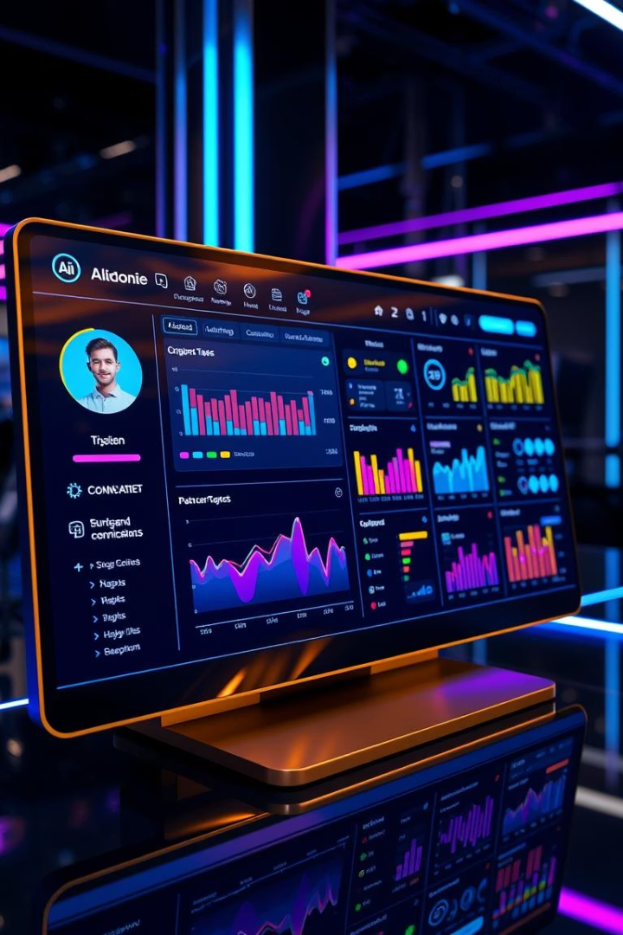
AI-Powered Task Management System
Transforming productivity with intelligent automation.
This presentation covers our AI-powered task management system, detailing its objectives, methodology, key features, and expected outcomes.
My system uses NLP and ML to streamline task management, leveraging a robust tech stack for intelligent automation.
Created By Abhisek Panda

Slide 2
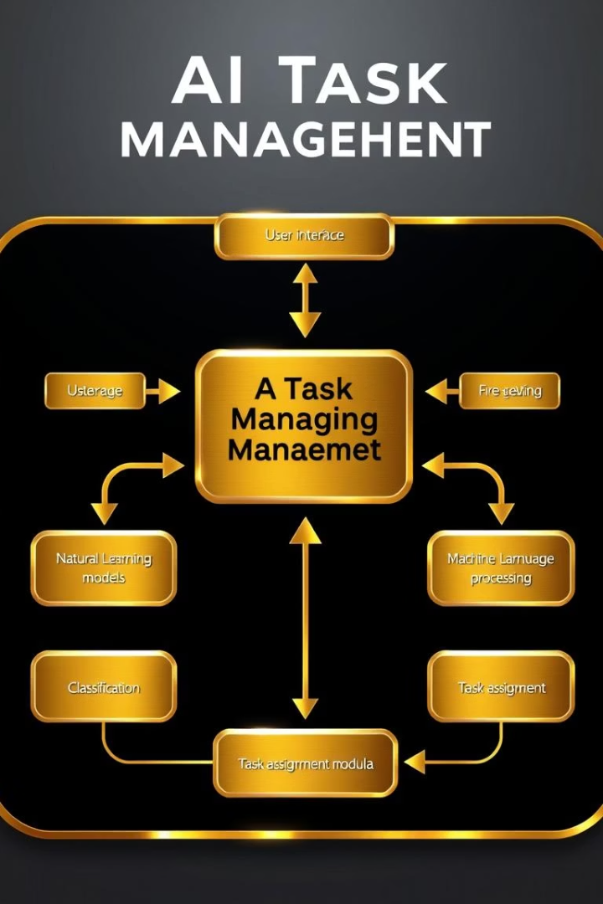


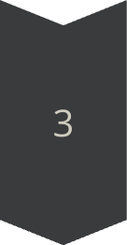
Overview & Methodology
Objective
Automate task classification and assignment using AI.
Key Features
Auto task categorization (NLP)
Priority prediction (ML)
Workload balancing
Tech Stack
Flask backend
Scikit-learn (ML/NLP)
Matplotlib/Seaborn (Visualization)
Our system uses NLP and ML to streamline task management, leveraging a robust tech stack for intelligent automation.

Slide 3
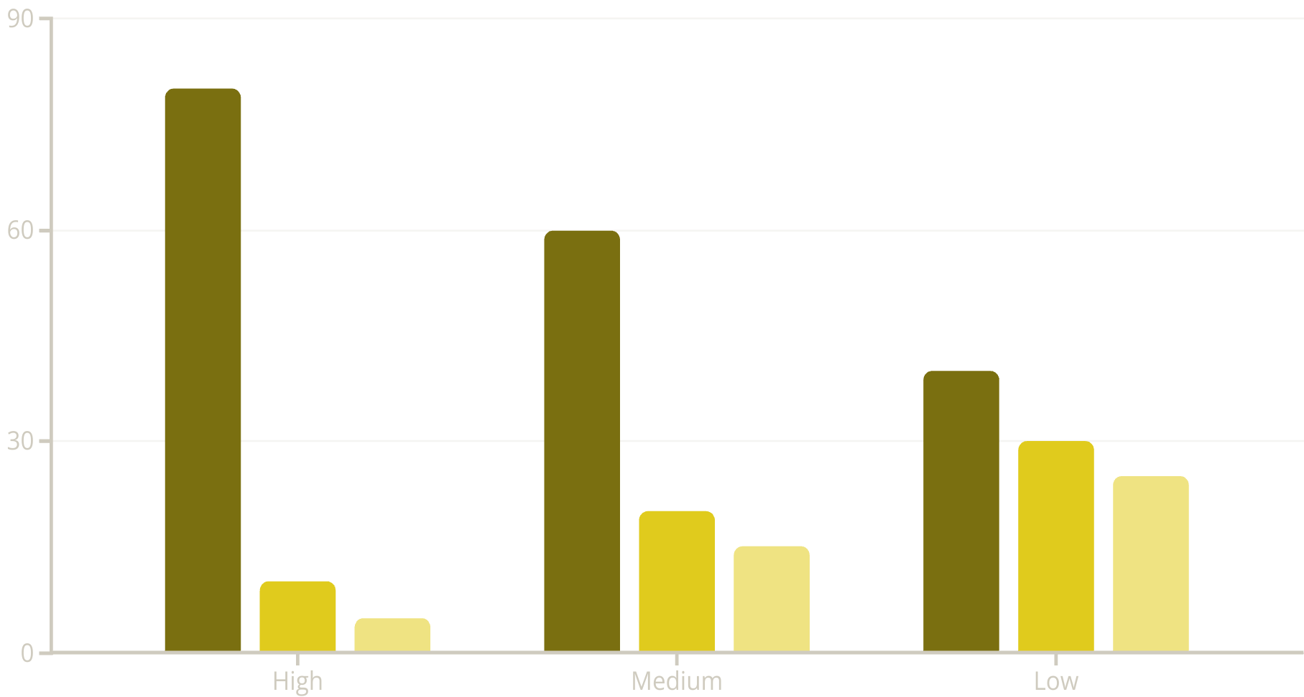

EDA Insights & System Capabilities
Completed
In Progress
Open
EDA reveals balanced task distribution across priorities. High-priority tasks are often completed faster, indicating efficient prioritization.
Smart Features
Analytics
Expected Outcomes
Predict task category
Real-time stats
Accurate classification (>80%)
Confidence scores
Completion rate
50% reduced manual effort
Overdue tasks
The system offers smart features, comprehensive analytics, and aims for high accuracy and efficiency gains.

